Slide 1
Financial Analytics Project Presentation
Aniket Chhaikuria

Slide 2
CONTENTS
Introduction
Problem Statement
Dataset Overview, Exploration & Cleansing
Key Metrics and Analysis
Findings and Insights
Conclusion & Recommendation

Slide 3
INTRODUCTION
To analyze competition among the top 500 companies in India by market capitalization using a dataset of financial metrics.

Slide 4
Problem Statement
Without analyzing competition, it is difficult for a business to survive. This project aims to provide insights into the competition among top companies to aid management decision-making.

Slide 5
Dataset Overview, Exploration & Cleansing
Overview
Explortion
Cleansing
Columns: Serial_Number, Company_Name, Mar_Cap_Crore (Market Capitalization in Crores), Sales_Qtr_Crore (Quarterly Sales in Crores)
The dataset contains financial metrics for the top 500 companies in India. Key steps in data exploration included understanding the structure of the dataset and performing necessary cleaning and preprocessing.
Technologies Used:
PostgreSQL
Tableau
Excel

Slide 6
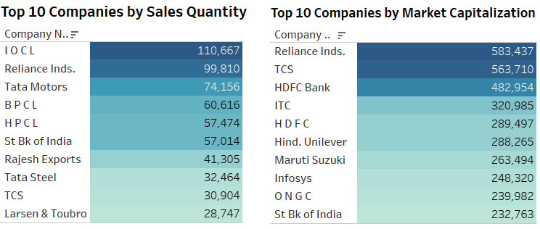

Slide 7
Key Metrics and Analysis
Key Metrics:
Average Market Capitalization: ₹27,526.65 Crores
Top Companies by Market Cap:
Reliance Industries - ₹583,436.72 Crores
TCS - ₹563,709.84 Crores
HDFC Bank - ₹482,953.59 Crores
Analysis:
The analysis focused on identifying companies with the highest market capitalization and understanding their relative positions in the market.

Slide 8
Findings and Insights
Correlation Between Market Cap and Sales:
While some companies with high market capitalization also show high quarterly sales, this is not a consistent trend across all companies. For example, Infosys and ONGC have high market capitalizations but are not in the top 10 for quarterly sales.
Conversely, some companies with high sales, like IOCL and Tata Motors, are not in the top 10 for market capitalization.

Slide 9
Dominant Players
Reliance Industries stands out by appearing at the top in both market capitalization and sales, indicating its robust financial performance and market dominance.

Slide 10
Sectoral Representation
The energy sector, represented by companies like Reliance Industries, IOCL, BPCL, and HPCL, shows strong sales figures, highlighting its significant contribution to the Indian economy.
The technology sector, with companies like TCS and Infosys, shows strong market capitalization, indicating high investor confidence and future growth potential.

Slide 11
Conclusion
The energy sector's significant sales figures underscore its importance to the economy, while the technology sector shows strong investor confidence with high market capitalization.
Reliance Industries emerges as a leader in both market capitalization and sales, showcasing its market dominance.
The analysis and visualizations provide a comprehensive view of the financial performance of the top 500 companies in India.

Slide 12
Recommendations
For Investors
For Businesses
For Policymakers
Consider a balanced portfolio with a mix of high market capitalization companies for potential growth and high sales companies for stable returns.
Focus on strategies that can improve both market capitalization and sales performance to attract investors and boost financial stability.
Support sectors that show high sales performance and have a critical role in the economy, such as the energy sector, to ensure continued growth and stability.

Slide 13
SUMMARY
This project analyzed the top 500 companies in India by market capitalization and quarterly sales using PostgreSQL, Excel and Tableau. Reliance Industries, TCS, and HDFC Bank led in market cap, while IOCL, Reliance Industries, and Tata Motors led in sales. The analysis highlighted the dominance of technology, financial, and energy sectors in the Indian market.

Slide 14
THANK YOU
Aniket Chhaikuria
ca26072000@gmail.com
https://github.com/aniketchhaikuria

Slide 15
References
Dataset Link: Top 500 Companies by Market Capitalization in India
Data Source: Provided by Unified Mentor

